Slide 1
EPSCOR Meeting
Charleston, West Virginia
October 31, 2018
Visit westvirginiaresearch.org/library/workshops-conferences/epscor-meeting-october-2018 for presentation downloads

Slide 2
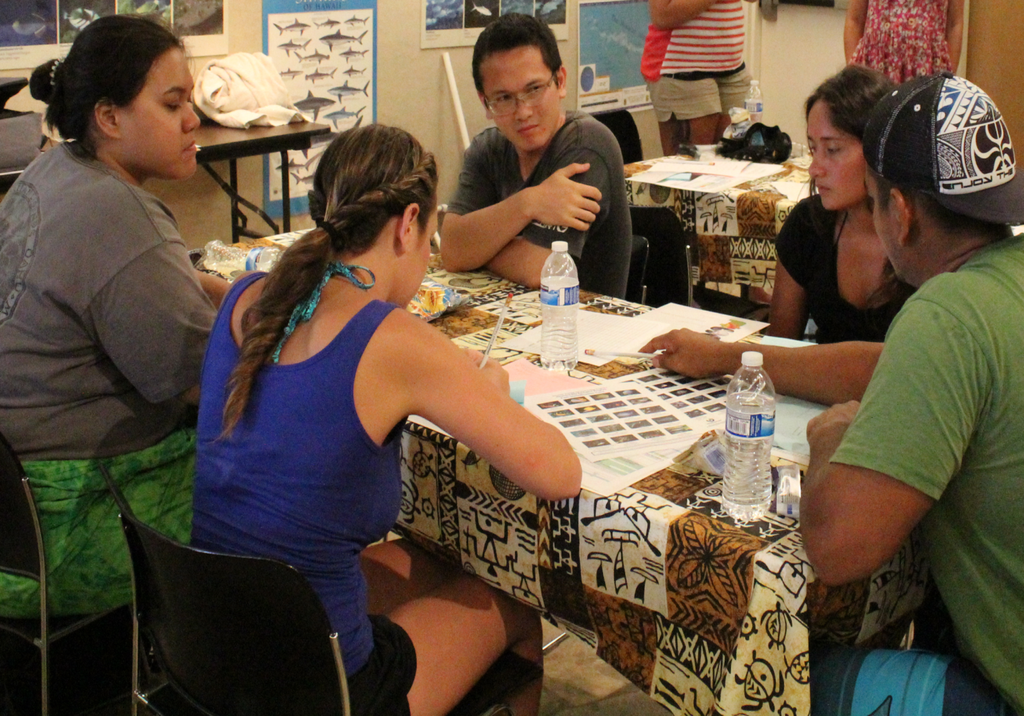
Active Learning
Barbara Cabezal Bruno
Hawai‘i Institute of Geophysics & Planetology
Co-PI & EOD, Hawai‘i EPSCoR

Slide 3
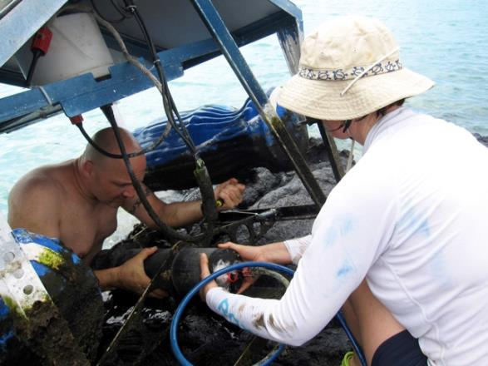
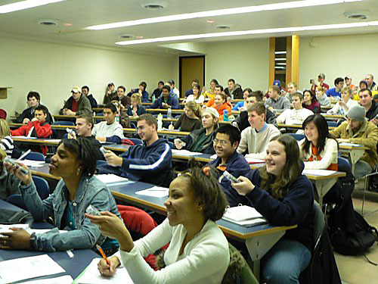
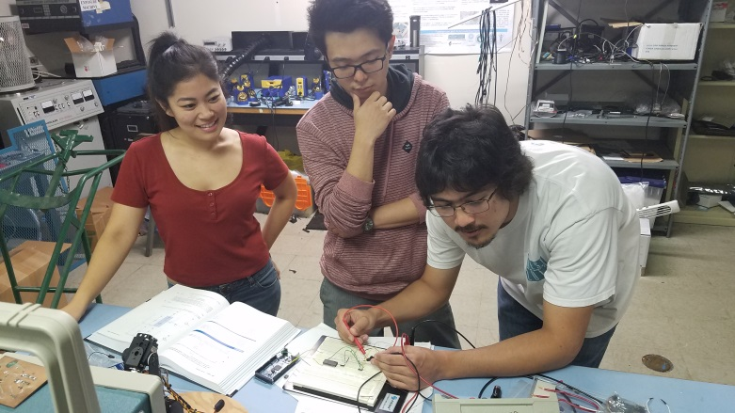
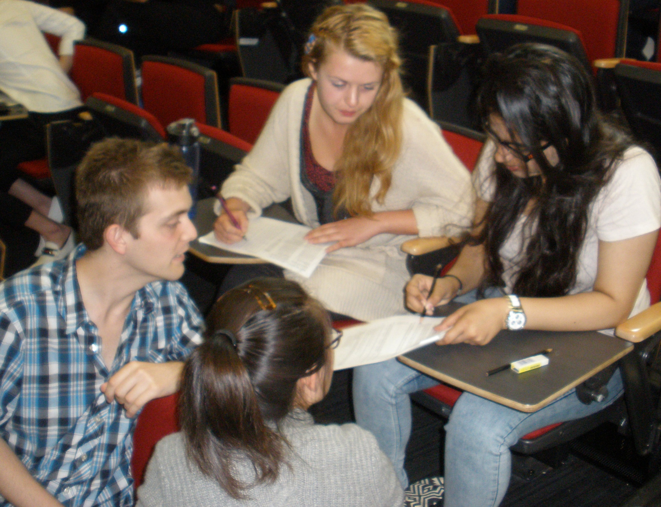
Active Learning Examples

Slide 4
Word-Pair Activity
bread/b_tter ocean/breeze
leaf/tree music/l_rics
sweet/sour sh_e/sock
phone/bo_k movie/actress
chi_s/salsa gasoline/engine
high school/college pen_il/paper
river/b_at turkey/stuffing
fruit/vegetable be_r/wine
computer/chip television/rad_o
l_nch/dinner chair/couch

Slide 5
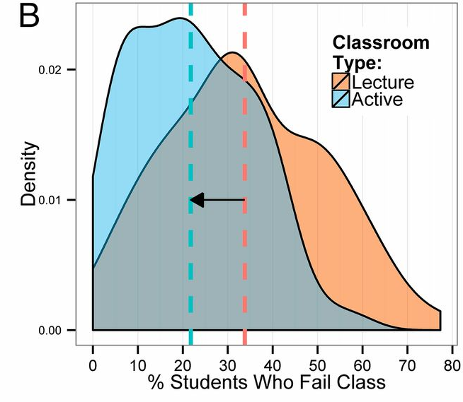
Meta-Analysis: Active Learning vs Lecturing B) Failure Rates
Freeman et al, 2014

Slide 6
Where do you get your teaching ideas/methods from?
When I ask University faculty this question ………..
What do you think is the most common reply?

Slide 7
Invitation to Collaborate with Hawai‘i
Education Goal: Establish an integrated set of pathways to train a diverse cohort of students, post-doctoral and faculty researchers at UH Mānoa and UH Hilo.
Selected 2019 Activities
Education Research
Implementing “tried & true” pedagogical strategies
Individualized Development Plans (IDPs)
Faculty coaching (pedagogy, mentoring)
Near-Peer Mentoring Cascade

Slide 8
EPSCOR Meeting
Charleston, West Virginia
October 31, 2018
Visit westvirginiaresearch.org/library/workshops-conferences/epscor-meeting-october-2018 for presentation downloads

Slide 9
Common Ways to Engage with Policymakers
American Geophysical Union’s guidelines:
Visit your legislator. You can make the trip to D.C. or simply visit your local or state legislator. Let them know who you are, what you do, and why it matters to them.
Call/write your legislator. Writer them a letter. They represent you; let them know why what you do matters.
Tweet your legislator. Politicians are increasingly responsive on social media. Send your Representative or Senator a tweet about a science issue that is important to you.
Invite your legislator to your university/lab. Established a dialogue with your legislator? Great! Why not invite them to come see where you work and how you do your research.

Slide 10
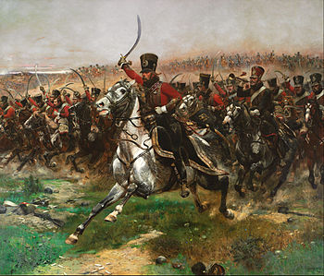
Understand their Minds
For all their diverse decisions they typically ask three questions:
What is the problem and do I have responsibility and authority for it?
Who will it affect? Are they my constituents?
If I take specific action (or don’t) who wins and who loses?
This is where you
come in!
Vive L'Empereur1891
Edouard Detaille | Art Gallery of New South Wales

Slide 11
So Who is the Audience?
Think:
Harried schedules
Limited attention spans
Little background knowledge.
“The work of congressional staff is fast-paced and pressurized, so adjust your explanations to their level of expertise, be concise, and offer concrete suggestions”
-Elizabeth O’Hare, a program officer on The National Academies' Board
on Higher Education and Workforce in Washington, D.C.

Slide 12
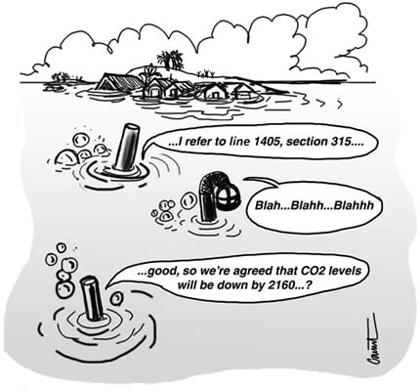
How to Make Your Science Useful
Be informed and prepared
Think timely
Keep your messages and answers brief and simple
Make your message actionable
Give your message life and relevance
NOT THIS: BUT THIS:
Communicating the High Fructose Corn Syrup Way:
A short, sharp shot of palatability will have them coming back for more.

Slide 13
Keep Your Message Brief and Simple
Deliver your message in “high fructose corn syrup form:”
A quick hit
Potent
Designed to stimulate the CNS immediately
"The most effective educational efforts feature simple clear messages, that are repeated often, by a variety of trusted voices.”
-Edward Maibach, director of the Center for Climate Change Communication
Notes:
In contrast to the IPCC reports, which are hard for the public and policymakers to digest, this report is concise, potentially giving it an advantage, Maibach noted.

Slide 14
Make your Message Actionable
Setting policy is about making decisions:
So if you are presenting your science, your goal is for the policymaker to agree that something must be done:
e.g. Reduce fossil fuels emissions, continue funding your research etc.
Think about what that something might be, and be prepared to explain the consequences of the various choices that might be proposed
Be ready for the question: What would Congress do?
And the next one: If you were confronting this problem with limited resources, what would be the first step you would take to solve it?

Slide 15
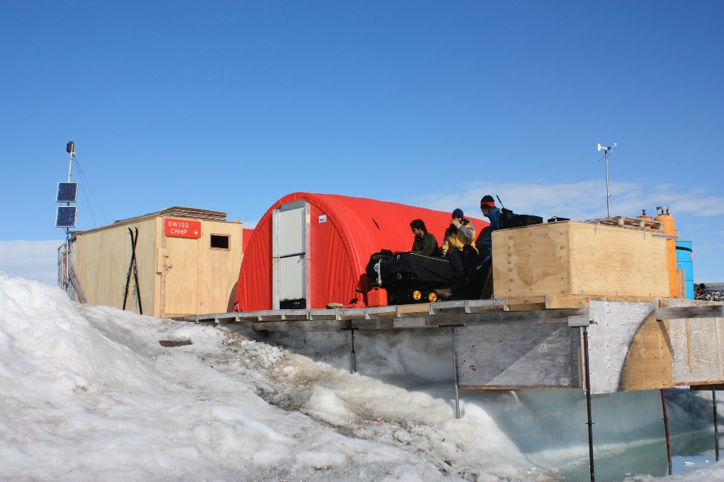
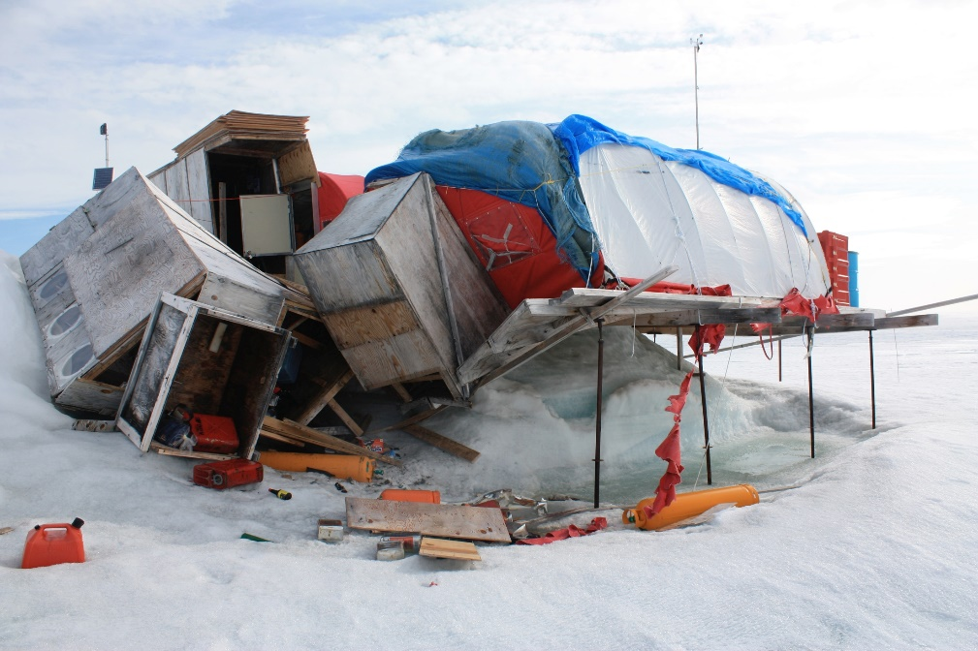
Make your Science Come Alive
Use personal stories and anecdotes
Swiss Camp Before Swiss Camp After
Notes:
Fallen weather towers, sunken scaffolds and toppled tents.
The collapsed camp—“Swiss Camp”—might have been the premier base to monitor the impacts of a changing climate on the Greenland ice sheet, but in 2009, the camp’s own appearance revealed more than a thousand data readings.
“We don’t need to measure the changes—we can look at the camp and see the changes,” said former CIRES Director Konrad Steffen, a Swiss native who established the camp in 1990 and has been returning there every summer since.
Warming temperatures have gradually melted the camp’s foundations causing it to collapse in a decidedly disorganized “un-Swiss-like” manner. Weather towers, placed more than a decade earlier in 2 meters of ice, have toppled as their foundation has begun to disappear.
The scene, as well as more than 20 years of data, spells out a stark reality: The Greenland ice sheet is melting faster than it is replenishing.
“Over the years we have lost first 30 centimeters of ice, then 50 centimeters of ice, then a meter,” Steffen said. “Overall we have lost 6 meters—so the losses are very visual.”
Lots of examples
The air used to be so pristine before …..
We used to test the air quality in Texas and it was so much worse before new regulations…Can we do that here too?
We used to measure the snowmelt, now it is three weeks earlier
This used to be a wooded area, not all you see is rotting trees

Slide 16
EPSCOR Meeting
Charleston, West Virginia
October 31, 2018
Visit westvirginiaresearch.org/library/workshops-conferences/epscor-meeting-october-2018 for presentation downloads

Slide 17
Tips for Preparing Soundbites
What is a soundbite?
“A way to communicate your message or an answer to a question in concise and quotable form for an outreach article, press release or the media.”
A good soundbite follows these guidelines:
It is tailored for the audience in question.
Keep it simple.
Avoid or explain jargon.
With just that little bit extra…
Notes:
Use these to convey your message or answer media questions

Slide 18
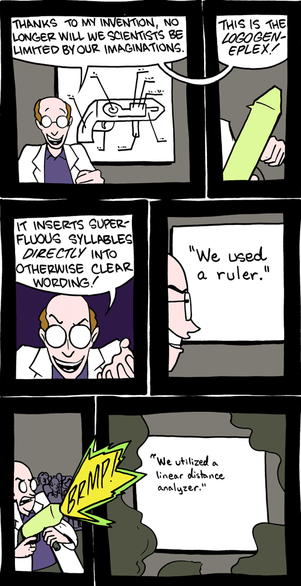
Tips for Preparing Soundbites
Keep it simple, but not simplistic.
—Use short sentences and short words without losing the message’s essence or meaning (“dumbing it down”)
http://smbc-comics.com/index.php?db=comics&id=1957#comic
Notes:
WALEED IS GOING TO DEMONSTRATE THESE PRINCIPLES

Slide 19
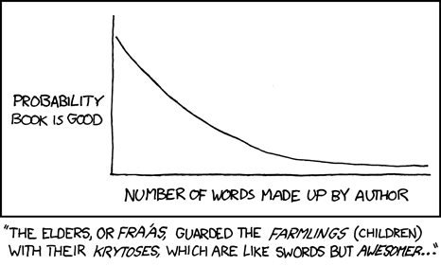
Tips for Preparing Soundbites
Avoid technical or scientific jargon.
—If you must use a scientific term, explain what it means.
—Avoid abbreviations or acronyms.
Xkcd.com.
Notes:
Jargon and acronyms are for lazy communicators.
I said at the beginning that “This is not rocket science” but there is a challenge on the Internet to communicate your science using the most common, I don’t know, 3,000 words.
Well some scientists was able to explain the functions and working of each component of a rocket using only those words. If rocket scientists can do that, you can explain your science without reverting to jargon.

Slide 20
What Is That Little Bit Extra?
It’s memorable! Surprising, catchy, humorous, or sobering
—Dan Vergano, science reporter for USA Today
“These are enormous geological events. Earth doesn’t do this very often. Something about the size of these things shakes you to the very core.”
—Brian Atwater, U.S. Geological Survey, talking about the December 2004 tsunami
“They are like the buttresses of the high cathedral. If you remove the buttress, the cathedral will collapse.”
—Jose Rial, University of North Carolina geohysicist, talking about the Greenland Ice Sheet slipping away.
“I thought, wow, this was a gold mine.” —Ray Huey, University of Washington, talking about global warming data seen in fruit flies.
“Reporters need a summary quote that captures some of the field’s interest in a topic, but delivers it forcefully.”

Slide 21
Common Questions from Journalists
What is the main result/finding?
Why should we/anyone care?
—What are the possible implications of the result?
—Is it an important result?
—Who could benefit from this research?
Are you the first person to look at this?
If not, what is novel about this research?
What is exciting or interesting about this research? (A quote getter)
Notes:
Obviously these questions are very generic and following a study these questions would be phrased more specifically. However, they will follow this general pattern.
WALEED
In each case were his answers:
Simple (short sentences, short words)
Audience-directed
Jargon free
Not every quote has to be memorable

Slide 22
Common Questions: One Layer Deeper
Couldn’t that result be due to x, y, or z?
—How do you know that the result is due to what you think it is due to?
Who disagrees with this result?
—On what basis?
—What do you think about their arguments?
People connect this result with phenomenon X:
—What are your thoughts on this?
—Who else should we ask about this?
Notes:
WALEED
In each case were his answers:
Simple (short sentences, short words)
Audience-directed
Jargon free
Not every quote has to be memorable

Slide 23
EPSCOR Meeting
Charleston, West Virginia
October 31, 2018
Visit westvirginiaresearch.org/library/workshops-conferences/epscor-meeting-october-2018 for presentation downloads

